Slide 1
AZ-104T00A Administer Data Protection

Slide 2


Administer Network Protection Introduction
Configure File and Folder Backups
Configure Virtual Machine Backups
Lab 10 – Implement Data Protection
Notes:
Module overview

Slide 3
Configure File and Folder Backups

Slide 4
Configure File and Folder Backups Introduction
Describe Azure Backup Benefits
Implement Azure Backup Center
Setup Recovery Service Vault Backup Options
Demonstration – Backup Azure File Shares
Configure On-premises File and Folder Backups
Manage the Microsoft Azure Recovery Services Agent
Demonstration – Backup Files and Folders
Summary and Resources
Notes:
Monitor and back up Azure resources (10–15%)
Implement backup and recovery
* Create a Recovery Services vault.
* Create and configure backup policy.
* Perform backup and restore operations by using Azure Backup.
* Configure and review backup reports.

Slide 5
Describe Azure Backup Benefits
Azure-based service used to back up and restore data in Microsoft cloud
Automatic Storage Management
Multiple storage options
Unlimited data transfer
Data encryption
Application consistent backup
Long-term retention
Notes:
Offsite backups – push on prem backups to Azure
Back up IaaS workloads with application consistency
Multiple storage options. Azure Backup offers two types of replication to keep your storage/data highly available.
Locally redundant storage (LRS) replicates your data three times (it creates three copies of your data) in a storage scale unit in a datacenter. All copies of the data exist within the same region. LRS is a low-cost option for protecting your data from local hardware failures.
Geo-redundant storage (GRS) is the default and recommended replication option. GRS replicates your data to a secondary region (hundreds of miles away from the primary location of the source data). GRS costs more than LRS, but GRS provides a higher level of durability for your data, even if there is a regional outage.
Azure VM backup, SQL in Azure VM backup, SAP HANA in Azure VM backup, Azure Files backup, Azure Blobs backup, Azure-managed disks backup, and Azure Database for PostgreSQL Server backup.

Slide 6
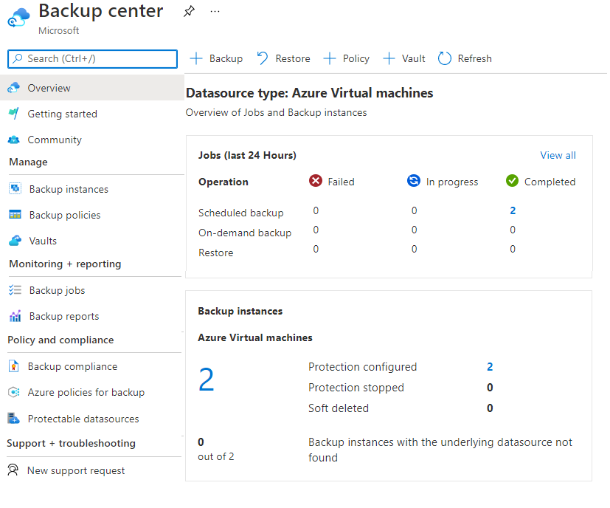
Implement Azure Backup Center
Single pane of glass to manage backups across a large and distributed Azure environment
Datasource-centric management focused on what you are backing up
Connected experiences with native integrations that enables management at scale
Notes:
Overview of Backup Center - https://docs.microsoft.com/azure/backup/backup-center-overview
Supported scenarios
Backup Center is currently supported for Azure VM backup, SQL in Azure VM backup, SAP HANA in Azure VM backup, Azure Files backup, Azure Blobs backup, Azure Managed Disks backup, and Azure Database for PostgreSQL Server backup.
Wide range of capabilities. Backup Center is designed to function well across a large and distributed Azure environment. You can use Backup Center to efficiently manage backups spanning multiple workload types, vaults, subscriptions, regions, and tenants.
Datasource-centric management. Backup Center provides views and filters that are centered on the datasources that you're backing up. Datasources like VMs and databases. This feature lets a resource owner or a backup admin administer backup items across different vaults. The admin can also filter views by datasource-specific properties. These properties include datasource subscription, datasource resource group, and datasource tags.
Connected experiences. Backup Center provides native integrations to existing Azure services that enable management at scale. For example, Backup Center uses the Azure Policy experience to help you govern your backups. It uses Azure workbooks and Azure Monitor Logs to help you view detailed reports on backups. So you don't need to learn any new principles to use the varied features that Backup Center offers. You can also discover community resources from the Backup Center.

Slide 7
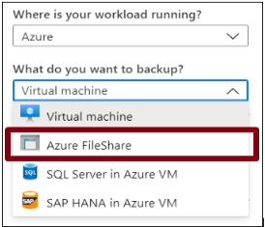
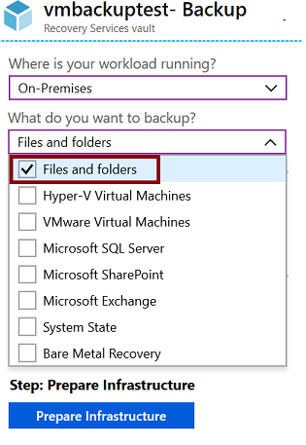
Setup Recovery Services Vault Backup Options - Files
Azure Workloads
On-Premises Workloads
Notes:
Recovery Services vaults overview - https://docs.microsoft.com/azure/backup/backup-azure-recovery-services-vault-overview
Create a Recovery Services vault - https://docs.microsoft.com/azure/backup/backup-create-rs-vault
Soft delete for virtual machines - https://docs.microsoft.com/azure/backup/soft-delete-virtual-machines

Slide 8
Configure Azure File & Folder Backup
Create Recovery Services Vault
Download Backup Agent and Credential File
Install Backup Agent and Connect to Recovery Services Vault with Credential File
Configure Files & Folders to Backup
Customer sets an encryption key which is required during a restore operation.
Microsoft have no visibility of the encryption key and the backup is useless without it.

Slide 9
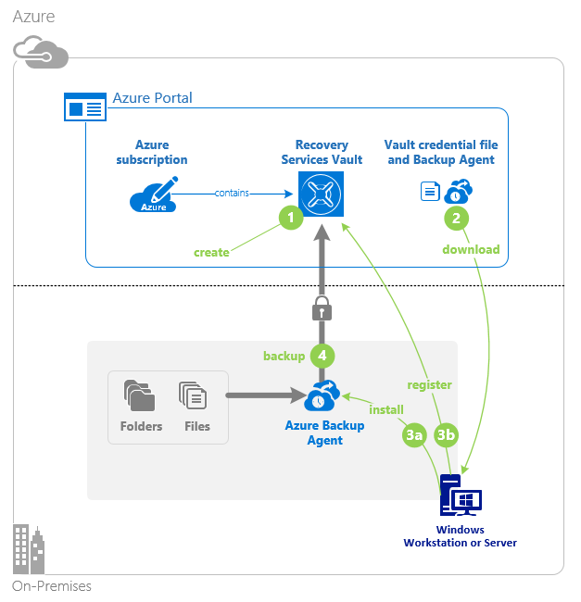
Configure On-Premises File and Folder Backup
Create the recovery services vault
Download the agent and credential file
Install and register agent
Configure the backup
Notes:
About Azure file share backup - https://docs.microsoft.com/azure/backup/azure-file-share-backup-overview
Back up Azure file shares - https://docs.microsoft.com/azure/backup/backup-afs

Slide 10
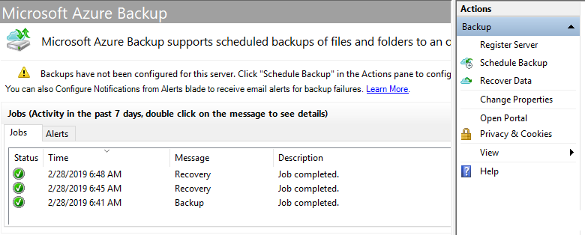
Manage the Microsoft Azure Recovery Services Agent
Backup or recover files and folders on physical or virtual Windows OS (VMs can be on-premises or in Azure)
No separate backup server required
Not application aware; file, folder, and volume-level restore only
No support for Linux
Notes:
Back up Windows Server files and folders to Azure -https://docs.microsoft.com/azure/backup/backup-windows-with-mars-agent

Slide 11
Demonstration – Backup Azure File Shares
Configure a storage account with file share
Create a Recovery Services vault
Configure file share backup
Verify the file share backup
Notes:
✔ Always consider having students walk-through the demonstrations themselves. Also, consider the overlap with the formal labs and your best use of time.

Slide 12
Demonstration – Backup Files and Folders
Create a Recovery Services vault
Backup files and folders
Configure the vault
Explore the recover settings
Install and register the agent
Explore the backup properties
Create the backup policy
Delete your backup schedule
Notes:
✔ Always consider having students walk-through the demonstrations themselves. Also, consider the overlap with the formal labs and your best use of time.

Slide 13
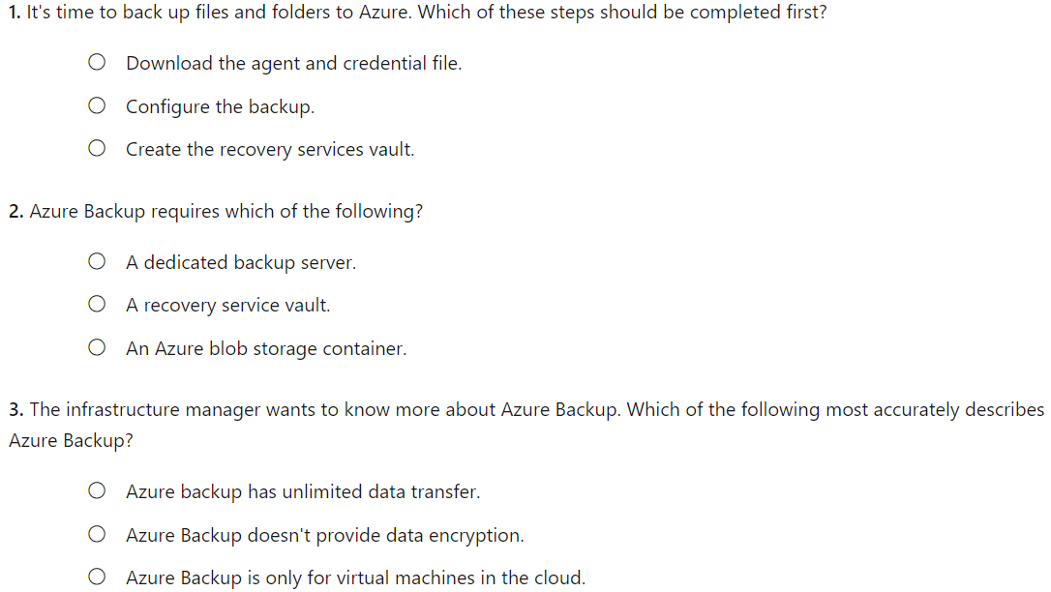
Knowledge Check
Notes:
C
B
A

Slide 14
Summary and Resources – Configure File and Folder Backups
Knowledge Check Questions
Microsoft Learn Modules (docs.microsoft.com/Learn)
Introduction to Azure Backup
Notes:
Learn - https://docs.microsoft.com/learn/browse
The Assessment Guide in the MCT DLC includes open-ended questions.
What workloads can Azure Backup back up? Discuss both on-premises and Azure workloads.
Answer: Azure Backup is the main tool to backup and restore workloads. On-premises workloads include files and folders, Hyper-V virtual machines, VMware virtual machines, Microsoft SQL Server, Microsoft SharePoint, Microsoft Exchange, System State, and Bare Metal Recovery. Azure workloads include virtual machines, Azure file shares, SQL Server in Azure VM, and SAP HANA in Azure VM.
You need to configure on-premises file and folder backups. What are basic steps to configuring the backup?
Answer: First, you will need to create a recovery service vault. Next, download the agent on the on-premises machine. The agent will need a credential certificate. Next, install and register the agent with Azure. Lastly, configure the backup policies. The portal provides a wizard to help with the agent steps.

Slide 15
Configure Virtual Machine Backups

Slide 16
Configure Virtual Machine Backups Introduction
Protect Virtual Machine Data
​Create Virtual Machine Snapshots​
Setup Recovery Services Vault Backup Options
Backup Virtual Machines
Restore Virtual Machines
Demonstration – Virtual Machine Backups
Implement Azure Backup Server​
Compare Backup Options
Manage Soft Delete​
Implement Azure Site Recovery
Summary and Resources
Notes:
Monitor and back up Azure resources (10-15%)
Implement backup and recovery
Configure Azure Backup reports
Perform backup and restore operations using the Azure Backup service
Create a recovery services vault
Create and configure backup policy
Perform site-to-site recovery using ASR

Slide 17
Protect Virtual Machine Data
Snapshots
Azure backup
Azure Site Recovery
Managed snapshots provide a quick and simple option for backing up VMs that use Managed Disks
Azure Backup supports application-consistent backups for both Windows and Linux VMs
Azure Site Recovery protects your VMs from a major disaster scenario when a whole region experiences an outage
Notes:
A managed disk snapshot is a read-only full copy of a managed disk that is stored as a standard managed disk by default. With snapshots, you can back up your managed disks at any point in time. These snapshots exist independent of the source disk and can be used to create new managed disks. They are billed based on the used size. For example, if you create a snapshot of a managed disk with provisioned capacity of 64 GiB and actual used data size of 10 GiB, that snapshot is billed only for the used data size of 10 GiB.
For backing up Azure VMs running production workloads, use Azure Backup. Azure Backup supports application-consistent backups for both Windows and Linux VMs. Azure Backup creates recovery points that are stored in geo-redundant recovery vaults. When you restore from a recovery point, you can restore the whole VM or just specific files
Azure Site Recovery protects your VMs from a major disaster scenario when a whole region experiences an outage due to major natural disaster or widespread service interruption. You can configure Azure Site Recovery for your VMs so that you can recover your application with a single click in matter of minutes. You can replicate to an Azure region of your choice.

Slide 18
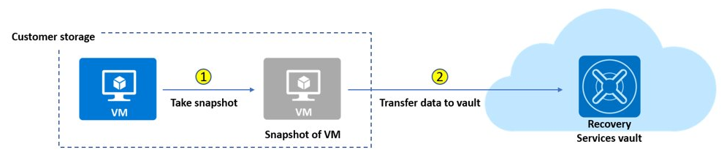
Create Virtual Machine Snapshots
Use snapshots taken as part of a backup job
Reduces recovery wait times – don’t wait for data transfer to the vault to finish
Configure Instant Restore retention (1 to 5 days)
Notes:
An Azure backup job consists of two phases. First, a virtual machine snapshot is taken. Second, the virtual machine snapshot is transferred to the Azure Recovery Services vault.
Ability to use snapshots taken as part of a backup job that is available for recovery without waiting for data transfer to the vault to finish.
Reduces backup and restore times by retaining snapshots locally, for two days by default. This default snapshot retention value is configurable to any value between 1 to 5 days.
Supports disk sizes up to 32 TB. Resizing of disks is not recommended by Azure Backup.
Supports Standard SSD disks along with Standard HDD disks and Premium SSD disks.
Incremental snapshots are stored as page blobs.
For premium storage accounts, the snapshots taken for instant recovery points count towards the 10-TB limit of allocated space.
You get an ability to configure the snapshot retention based on the restore needs. Depending on the requirement, you can set the snapshot retention to a minimum of one day in the backup policy blade as explained below. This will help you save cost for snapshot retention if you don’t perform restores frequently.
AZURE ULTRA DISKS do not support Backup

Slide 19
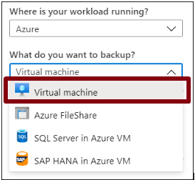
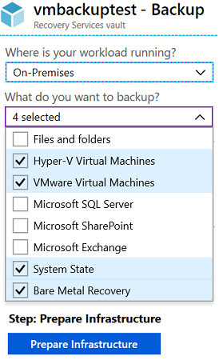

Setup Recovery Services Vault Backup Options - VMs
Azure Workloads
On-Premises Workloads
Multiple servers can be protected using the same Recovery Services vault

Slide 20
Backup Virtual Machines
Create a recovery services vault
Use the Portal to define the backup
Backup the virtual machine
1
2
3
Use a Recovery Services Vault in the region where you are performing your Virtual Machine backups and choose a replication strategy for Vault
Take snapshots (recovery points) of your data at defined intervals. These snapshots are stored in recovery services vaults
For the Backup extension to work, the Azure VM Agent must be installed on the Azure virtual machine
Notes:
Plan your VM backup infrastructure in Azure - https://docs.microsoft.com/azure/backup/backup-azure-vms-introduction
Tutorial: Back up and restore files for Windows virtual machines in Azure - https://docs.microsoft.com/azure/virtual-machines/windows/tutorial-backup-vms

Slide 21
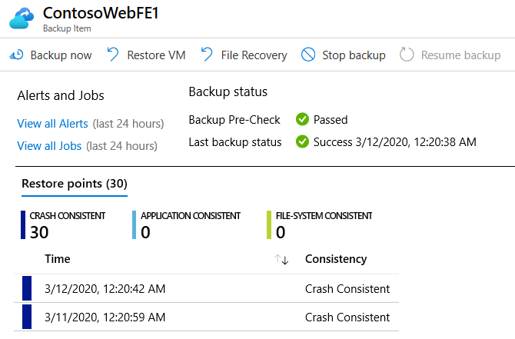
Restore Virtual Machines
Once you trigger the restore operation, the Backup service creates a job for tracking the restore operation
The Backup service also creates and temporarily displays notifications, so you monitor how the backup is proceeding

Slide 22
Demonstration – Virtual Machine Backups
Enable a backup on a virtual machine
Start a backup job and monitor the progress
Notes:
✔ Always consider having students walk-through the demonstrations themselves. Also, consider the overlap with the formal labs and your best use of time.

Slide 23

Implement Azure Backup Server (MABS)
Azure
Specialized Workloads
Virtual Machines
Files/Folders/Volumes
System Center DPM
Or Azure Backup Server
App-aware backups, file/folder/volume backups, and machine state backups (bare-metal, system state)
Each machine runs the DPM/MABS protection agent, and the MARS agent runs on the MABS/DPM
Flexibility and granular scheduling options
Manage backups for multiple machines in a protection group
Notes:
Application consistent backups for things like Sharepoint and Exchange.
Machine state and system state, backups can go to bare metal.
DPM/MABS protection agent is required on the protected servers.
Protection groups are used to group together VMs

Slide 24
Install Azure Backup Server (MABS)
Install MABS Application on Server (on prem).
Configure MABS Storage Pool
MABS requires a local storage pool as a staging area.
Backup data is placed on the staging area before being shipped to Azure.
Install MABS Protection Agent on Protected Machines (P or V).
Create Protection Groups for Protected Machines.
Configure Backups – Files, Folders, Volumes etc.
Configure Backup Schedule and Retention Policy
MARS Agent is used to ship online data to Azure.
The Azure Backup Server is built on the same code base as DPM.

Slide 25
Compare Backup Options
Component | Benefits | Limits | Protects | Backup Storage
Azure Backup (MARS) agent | Backup files and folders on physical or virtual Windows OS No separate backup server required | Backup 3x per day Not application aware File, folder, and volume-level restore only No support for Linux | Files Folders | Recovery services vault
Azure Backup Server (MABS) | App aware snapshots Full flex for when to backups Recovery granularity Linux support on Hyper-V and VMware VMs Backup and restore VMware VMs Doesn’t require a System Center license | Cannot backup Oracle workloads Always requires live Azure subscription No support for tape backup | Files Folders Volumes VMs Applications Workloads | Recovery services vault Locally attached disk

Slide 26
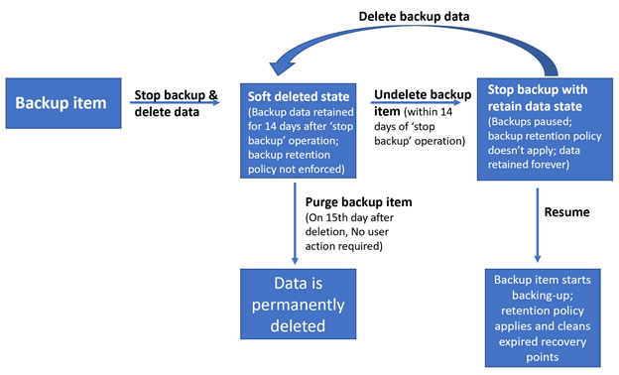
Manage Soft Delete
Backup data is retained for 14 additional days
Recover soft deleted backup items using an ‘Undelete’ operation
Also available for storage account containers and file shares
Natively built-in for all the recovery services vaults
Notes:
Protects against erroneously modified or deleted by an application or other storage account user.
Soft delete for VMs protects the backups of your VMs from unintended deletion. Even after the backups are deleted, they're preserved in soft-delete state for 14 additional days.

Slide 27
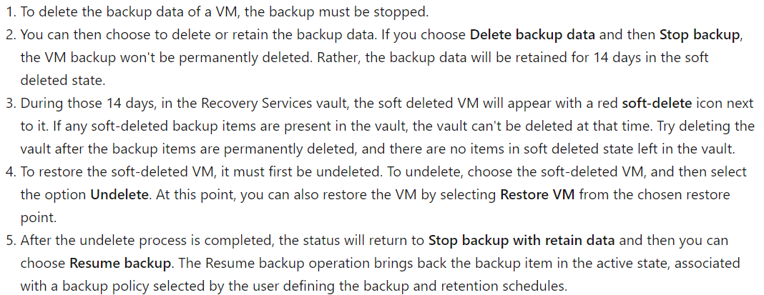
Azure Backup Soft Delete : Flow
Notes:
Soft delete only protects deleted backup data. If a VM is deleted without a backup, the soft-delete feature won't preserve the data. All resources should be protected with Azure Backup to ensure full resilience.

Slide 28
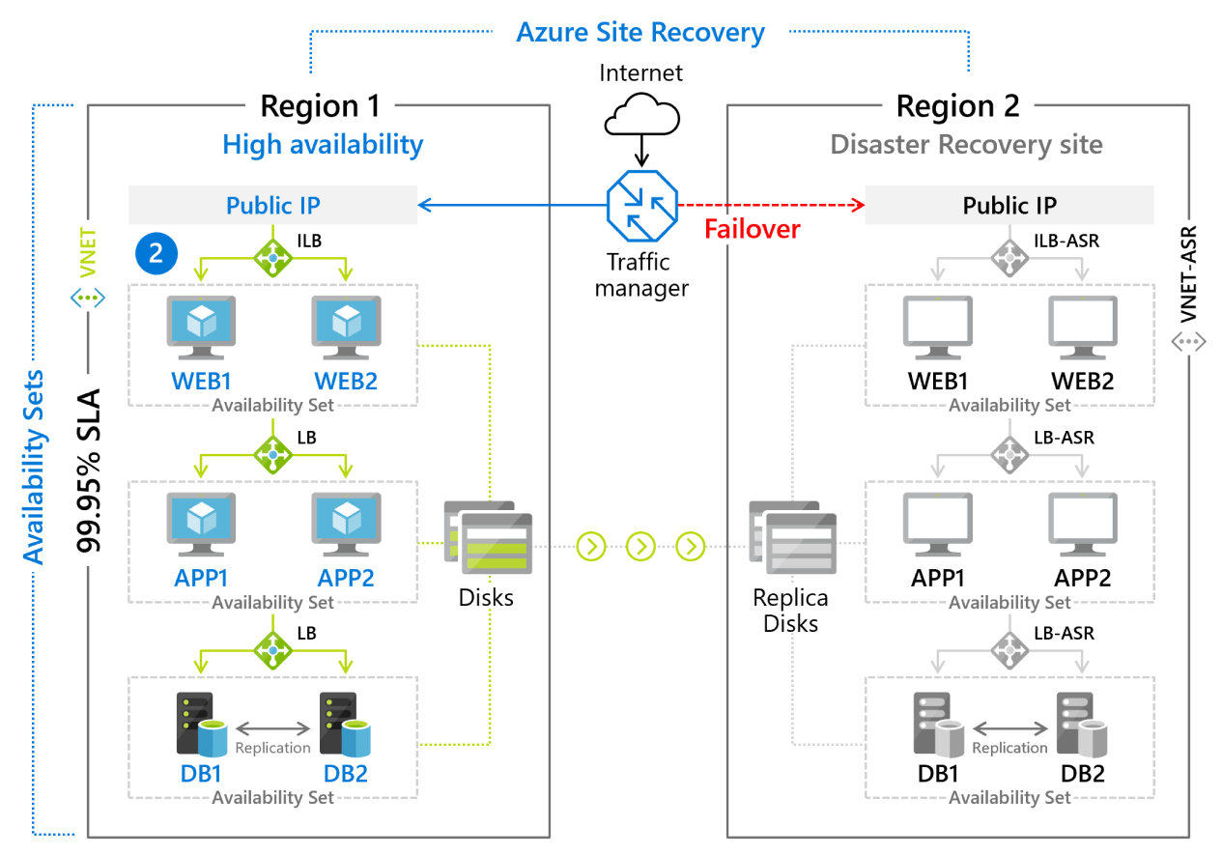
Implement Azure Site Recovery
Replicate Azure VMs from one Azure region to another
Replicate on-premises VMware VMs, Hyper-V VMs, physical servers (Windows and Linux), Azure Stack VMs to Azure
Replicate AWS Windows instances to Azure
Replicate on-premises VMware VMs, Hyper-V VMs managed by System Center VMM, and physical servers to a secondary site
Notes:
Azure Site Recovery documentation - https://docs.microsoft.com/azure/site-recovery/
Concentrate on replication within Azure and not migration scenarios from on-premises.
Note: Physical servers replicated to Azure using Site Recovery can only fail back as VMware VMs. You need a VMware infrastructure in order to fail back. https://docs.microsoft.com/azure/site-recovery/physical-to-azure-failover-failback#prepare-for-reprotection-and-failback

Slide 29
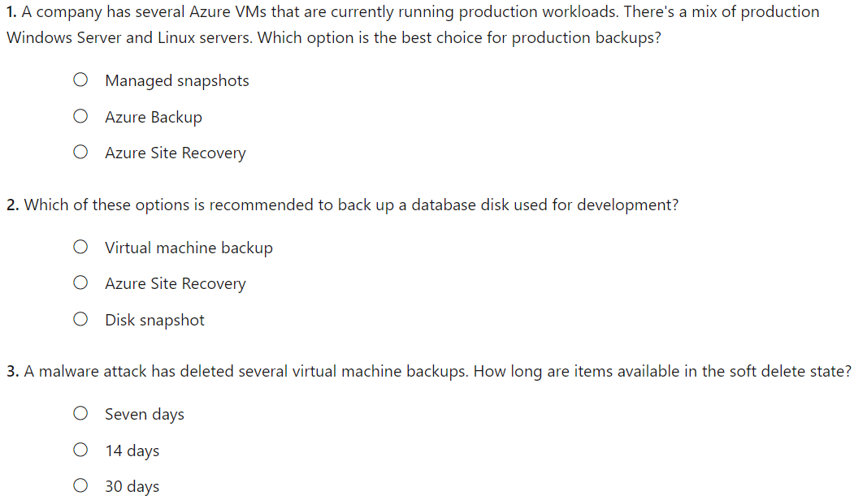
Knowledge Check
Notes:
A
C
B

Slide 30
Summary and Resources – Configure Virtual Machine Backups
Knowledge Check Questions
Microsoft Learn Modules (docs.microsoft.com/Learn)
Introduction to Azure Backup
Protect your virtual machines by using Azure Backup
Implement hybrid backup and recovery with Windows Server IaaS
Protect your Azure infrastructure with Azure Site Recovery
Notes:
Learn - https://docs.microsoft.com/learn/browse
The Assessment Guide in the MCT DLC includes open-ended questions.
Name at least two ways you can protect virtual machine data.
Answer: Virtual machine snapshots provide a quick and simple option for backing up VMs that use managed disks. Snapshots help capture information between formal backups. Azure Backup supports application-consistent backups for both Windows and Linux VMs. Azure Site Recovery protects your VMs from a major disaster scenario when a whole region experiences an outage.
Several of your virtual machine backups have been accidentally deleted. Is there are any way to recover the deleted backups?
Answer: Soft delete has the capability to protect cloud backups for IaaS virtual machines from accidental as well as malicious deletion of backups. Soft delete provides 14 days of extended retention, allowing recovery with no data loss. Soft delete is offered at no cost and is natively built-in for all recovery service vaults. To recover the deleted backups, use the undelete feature.
What is the difference between Azure Backup and Azure Site recovery?
Answer: Azure Backup allows for granular backups and restores specific data. Azure Site Recovery (ASR) allows for the protection of an entire production site. ASR provides automation and orchestration to make the failover and failback processes seamless.

Slide 31
Lab 10 – Implement Data Protection

Slide 32
Lab 10 – Backup virtual machines
Lab scenario
You have been tasked with evaluating the use of Azure Recovery Services for backup and restore of files hosted on Azure virtual machines and on-premises computers. In addition, you want to identify methods of protecting data stored in the Recovery Services vault from accidental or malicious data loss
Objectives
Task 1: Provision the lab environment
Task 2: Create a Recovery Services vault
Task 3: Implement Azure virtual machine-level backup
Task 4: Implement File and Folder backup
Task 5: Perform file recovery by using Azure Recovery Services agent
Task 6: Perform file recovery by using Azure virtual machine snapshots
Task 7: Review the Azure Recovery Services soft delete functionality
Next slide for an architecture diagram
Notes:
LAB 10 - Implement Data Protection - ESTIMATED DURATION 50 MIN
Lab Repository - https://microsoftlearning.github.io/AZ-104-MicrosoftAzureAdministrator/

Slide 33





Lab 10 – Architecture diagram
Task 1
Task 2
az104-10-rg0
az104-10-rg1
az104-10-vnet 10.0.0.0/24
Task 7
Subnet0 10.0.0.0/26
az104-10-rsv1
Task 3: Backup VM
Task 6: Recover File
az104-10-vm0
10.0.0.4
az104-10-vm0 Backup
Task 4: Backup File
Task 5: Recover File
az104-10-vm1
10.0.0.5
File Backup from az104-10-vm1
C:\Windows\System32\drivers\etc\hosts

Slide 34

End of presentation

Slide 35
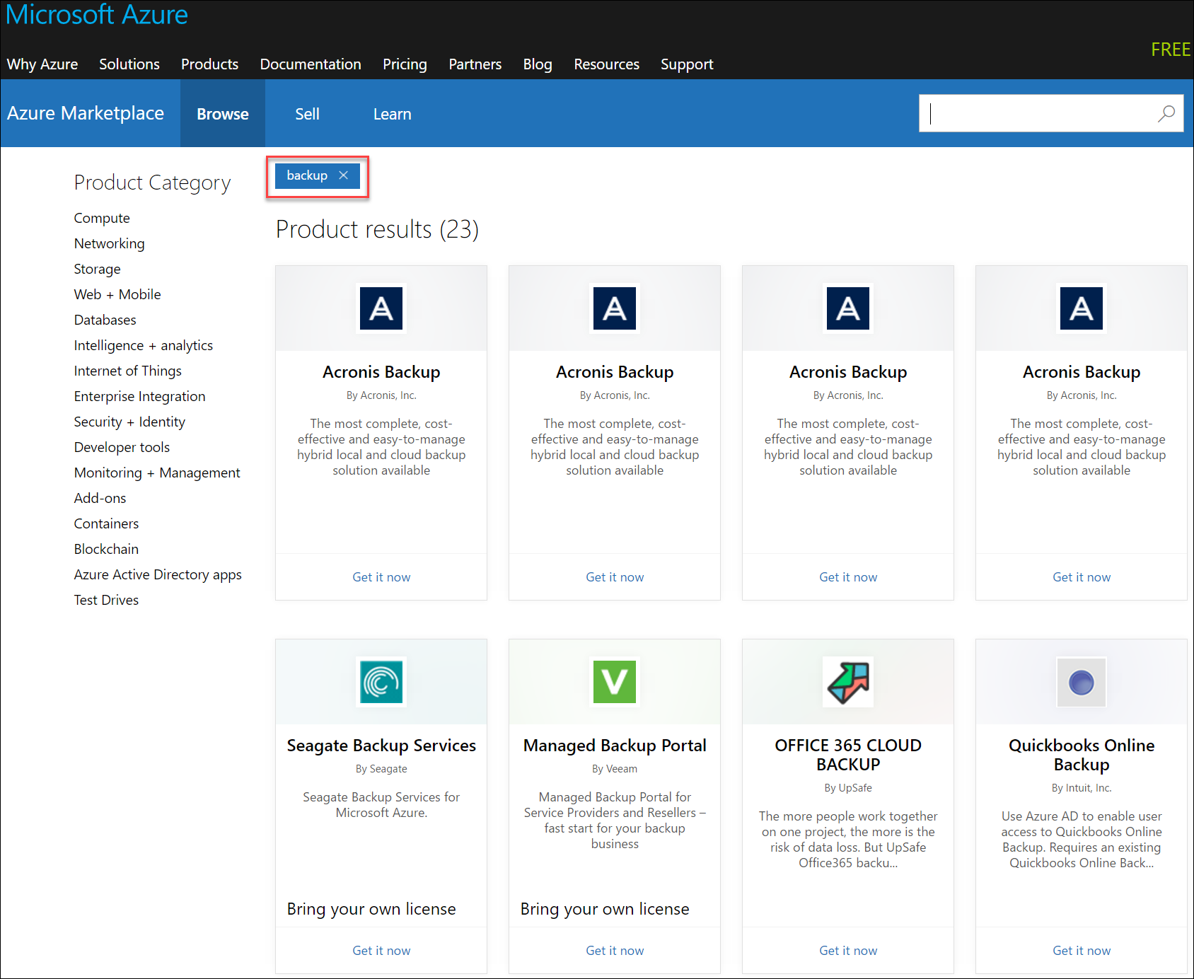
Workload Protection Needs
Many backup options are available
How the workload is being protected today?
How often is the workload is backed up?
What types of backups are being done?
Is disaster recovery protection in place?

Slide 36

Azure to Azure Architecture
VM is registered with Azure Site Recovery
Data is continuously replicated to cache
Source Environment (East US)
Target Environment (Central US)
Storage Account
Cache
Data
Data
Flow
Storage Account
3
Cache is replicated to the target storage account
2
Data
Flow
4
Failover
1
During failover the virtual machine is added to the target environment

